Slide 1
Network Topologies
Topic 6A

Slide 2
Learning Outcomes
By the end of this lesson, you should be able to:
Describe the primary physical networking topologies in common use
Describe the primary logical networking topologies in common use
Describe major LAN networking technologies
Compare Wi-Fi standards

Slide 3
Physical Topologies
The word “topology” describes the lay of the land
A network topology describes how a network is physically laid out and how signals travel from one device to another
The physical layout of the devices and cables doesn’t describe how signals travel from one device to another
Network topologies are categorized into physical and logical topologies
The arrangement of cabling and how cables connect one device to another in a network is considered the network’s physical topology
The path data travels between computers on a network is considered the network’s logical topology
All network designs today are based on these basic physical topologies: bus, star, ring, and point-to-point

Slide 4
Physical Bus Topology
Physical bus topology is defined as a continuous length of cable connecting one computer to another in daisy-chain fashion
The simplest and at one time the most common method for connecting computers
Weaknesses
There’s a limit of 30 computers per cable segment
The maximum total length of cabling is 185 meters
Both ends of the bus must be terminated
Any break in the bus brings down the entire network
Adding or removing a machine brings down the entire network temporarily
Technologies using this topology are limited to 10 Mbps half-duplex communication since they use coaxial cabling
Due to the limitations, this topology is no longer a practical choice and technology has moved past this obsolete method of connecting computers

Slide 5
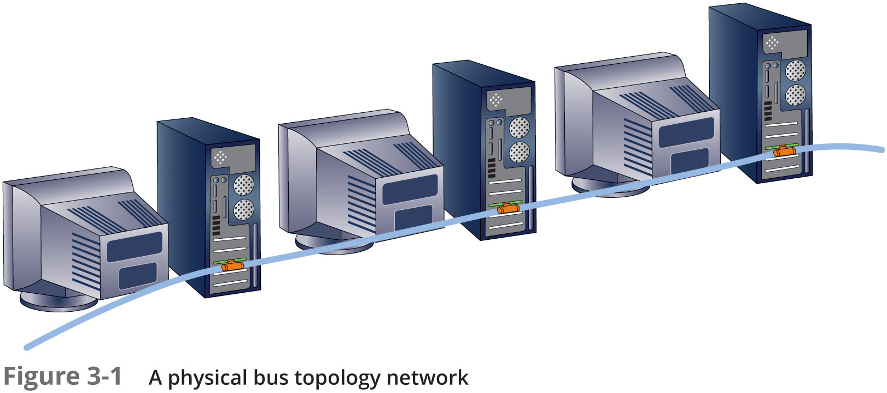
Physical Bus Topology

Slide 6
Physical Bus Topology
How Data Travels in a Physical Bus
Electrical pulses (signals) travel the cable’s length in all directions
Signals travelling across the medium and from device to device is called signal propagation
The signal continues until it weakens or is absorbed by a terminator
A terminator is an electrical component called a resistor that absorbs the signal instead of allowing it to bounce back up the wire
If not terminated, the signal bounces or is “reflected” at end of medium
Signal bounce is the term used when electricity bounces off the end of a cable and back in the other direction

Slide 7
Physical Bus Topology
Physical Bus Limitations
Only 30 computers can be daisy-chained together before signal becomes too weak to be passed along to another computer
As an electrical signal encounters each workstation along a daisy-chain,
Some of its strength is absorbed by both the cabling and the connectors until the signal is too weak for a NIC to interpret
For the same reason, total length of cabling is limited to 185 meters
Has a maximum bandwidth of 10 Mbps half-duplex communication
Due to use of coaxial cable

Slide 8
Physical Star Topology
Uses a central device (hub or switch) to connect computers
Each computer has a single length of cable going from its NIC to the central device
Advantages:
Much faster technologies than a bus
Centralized monitoring and management of network traffic are possible
Easier network upgrades
Using a central device allows for monitoring and managing a network
Hubs and switches can include software that collects statistics about network traffic patterns and detect errors
As long as cabling and NICs support it, a star network can be easily updated by replacing the central device
When the number of workstations you need exceed the number of ports on a central device you simply add another central device

Slide 9
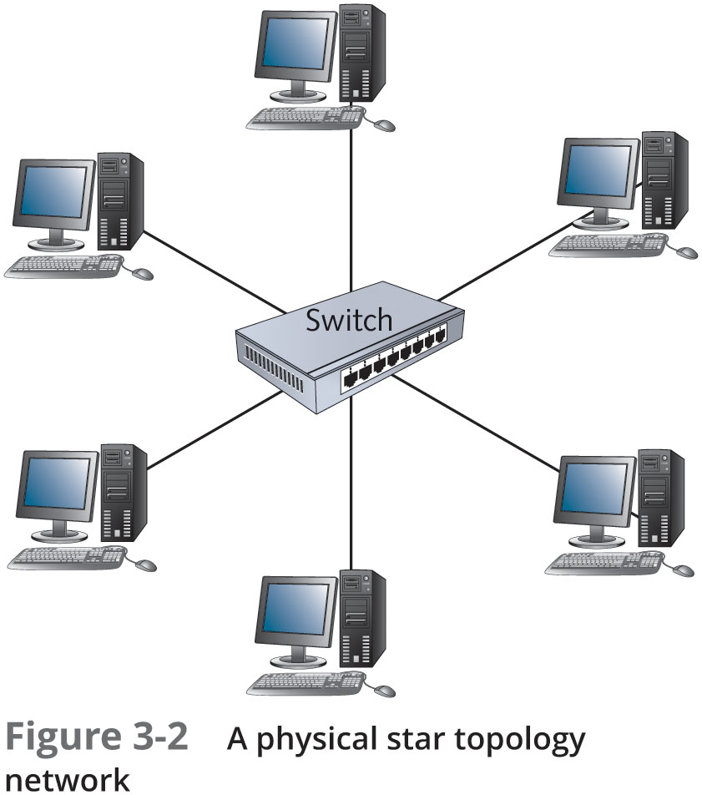
Physical Star Topology

Slide 10
Physical Star Topology
Extended Star
The extended star topology is the most widely used in networks containing more than just a few computers
A central device (usually a switch) sits in the middle and instead of attached computers, other switches or hubs are connected to the central switch’s ports
Computers and peripherals are then attached to these switches or hubs forming additional stars
Sometimes referred to as a “hierarchical star”
This topology is most effective when the center of the star is running at a much faster speed than other devices

Slide 11
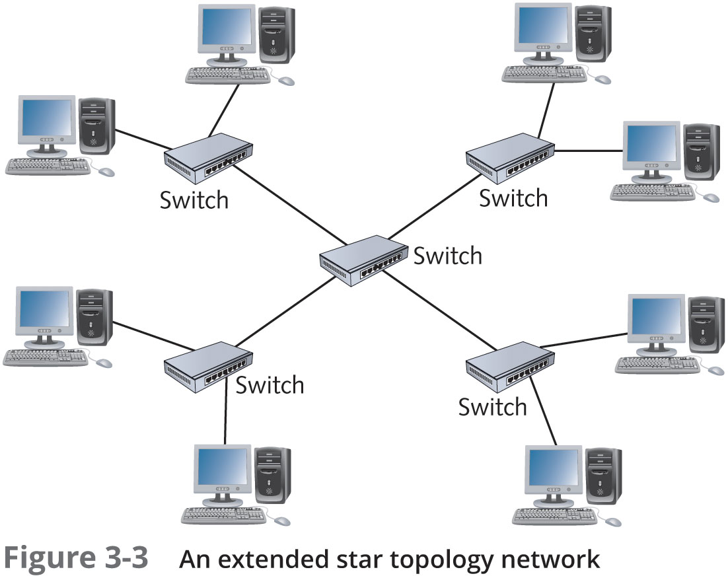
Physical Star Topology

Slide 12
Physical Star Topology
How Data Travels in a Physical Star
Details of how data travels in a physical start depend on the type of central device
The central device determines ‘logical’ topology
Logical topology is discussed later in the chapter
For now: hub = logical bus; switch = logical switching; MAU = logical ring
Physical Star Disadvantages
There are many advantages of a physical star
The main disadvantage is that the central device represents a single point of failure
If the hub or switch fails or someone kicks the power cord out of the outlet, the entire network goes down
Having a spare on hand is a good idea

Slide 13
Physical Ring Topology
A physical ring topology is like a bus:
Devices are daisy-chained one to another
Instead of terminating each end, the cabling is brought around from the last device back to the first device to form a ring
This topology was most widely used to connect LANs with a technology called Fiber Distributed Data Interface (FDDI)
FDDI was most often used as a network backbone, which is cabling used to communicate between LANs or between hubs and switches
Data travels in one direction
If any station in the ring fails, data can no longer be passed along
FDDI uses a dual ring, which means:
Data travels in both directions
One ring failure doesn’t break network
Extended star topologies with Gigabit Ethernet has largely replaced FDDI

Slide 14
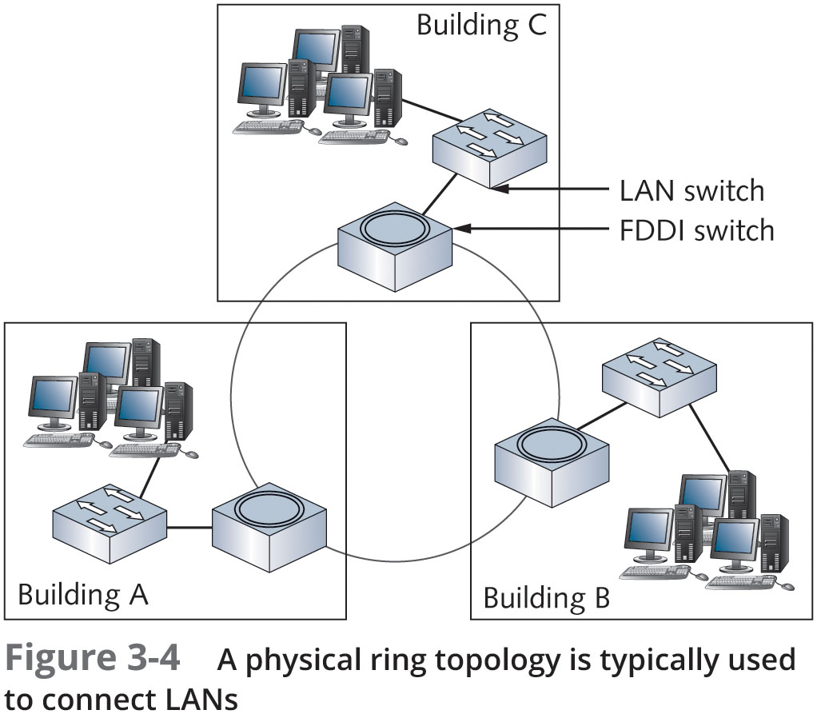
Physical Ring Topology

Slide 15
Point-to-Point Topology
A point-to-point topology is a direct link between two devices
Mostly used in WANs
Advantage of this topology:
Data travels on a dedicated link and bandwidth is not shared with other networks
Disadvantage of this topology:
Expensive
Point-to-point technologies are used with wireless networks as a wireless bridge
This setup can be used to connect two buildings without using a wired network
Can also be used to connect two computers together for transferring files

Slide 16
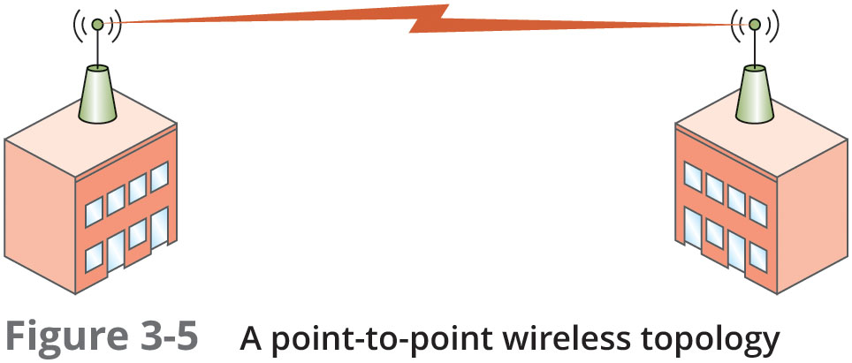
Point-to-Point Topology

Slide 17
Point-to-Point Topology
Point-to-Multipoint Technology
Point-to-multipoint (PMP) topology is an arrangement where a central device communicates with two or more other devices
All communication goes through the central device
It is often used in WANs where a main office has connections to several branch offices via a router
A single connection is made from the router to a switching device that directs traffic to the correct branch office
Also used in wireless network arrangements
A single base station communicates with multiple subscriber stations

Slide 18
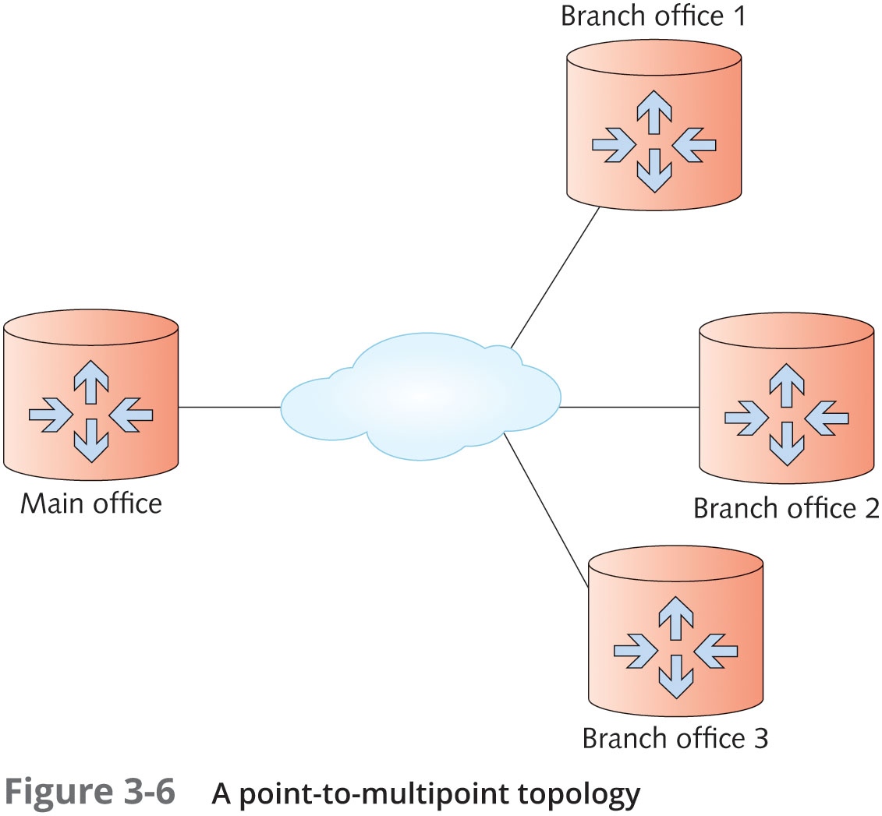
Point-to-Point Topology

Slide 19
Point-to-Point Topology
Mesh Topology
A mesh topology connects each device to every other device in a network
Multiple point-to-point connections for the purposes of redundancy and fault tolerance
The purpose of creating a mesh topology is to ensure that if one or more connections fail, there’s another path for reaching all devices on the network
Found in large WANs and internetworks
It is expensive due to multiple interfaces and cabling

Slide 20
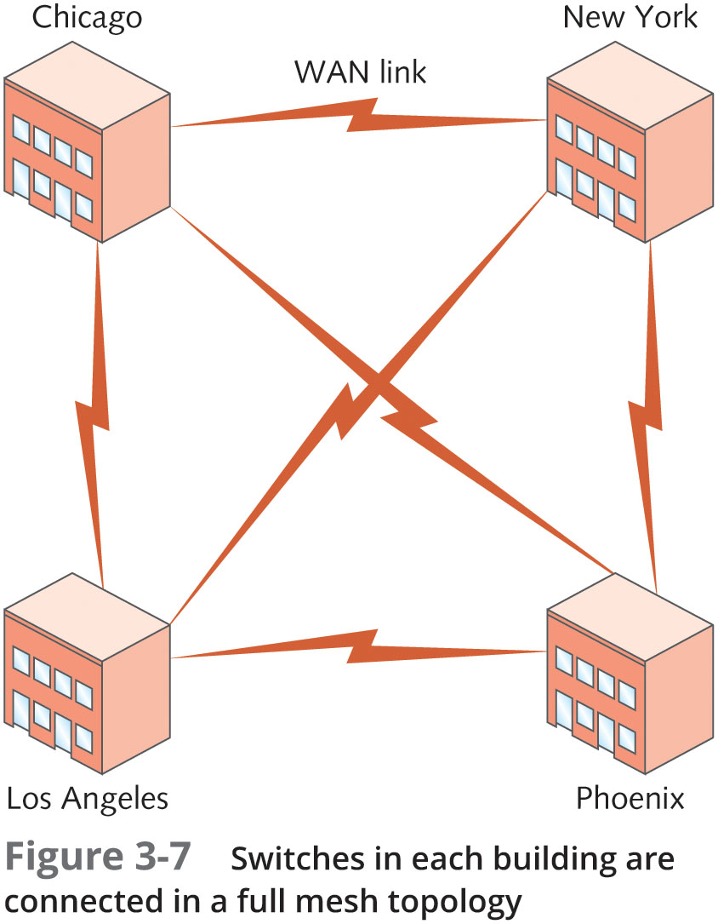
Point-to-Point Topology

Slide 21
Logical Topologies
A network’s logical topology describes how data travels from computer to computer
Sometimes same as physical topology
In a physical bus and physical ring, the logical topology mimics the physical arrangement of cables
For physical star, electronics in central device determine logical topology
A logical ring using a physical star implements the ring inside the central device’s electronics, which is a MAU in the token ring technology
In a switched topology, there is always an electrical connection between the computer and the switch
But when no data is being transferred there is no logical connection or circuit between the devices

Slide 22
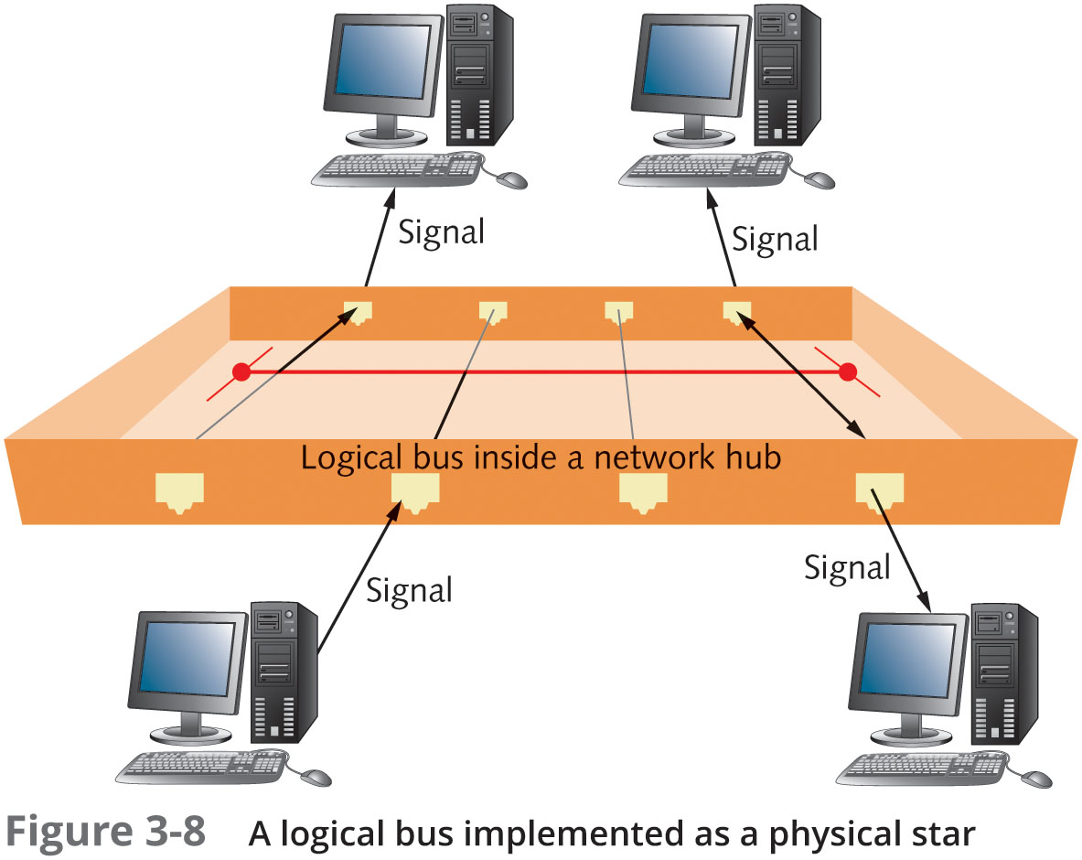
Logical Topologies

Slide 23
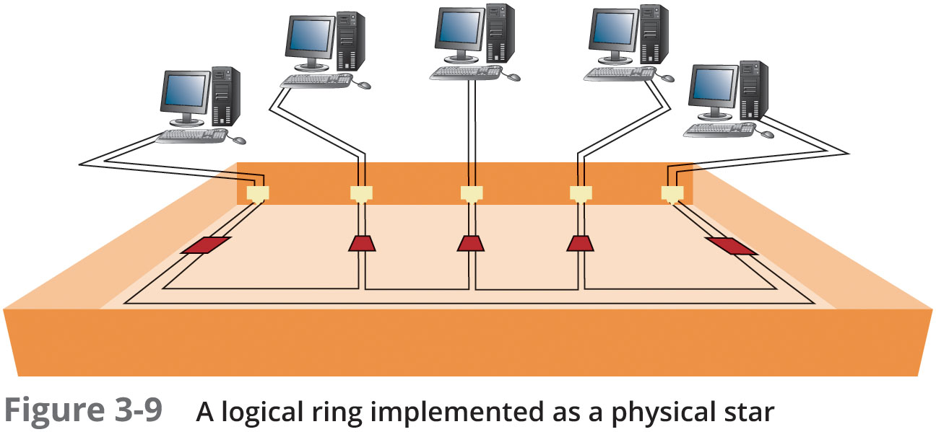
Logical Topologies

Slide 24
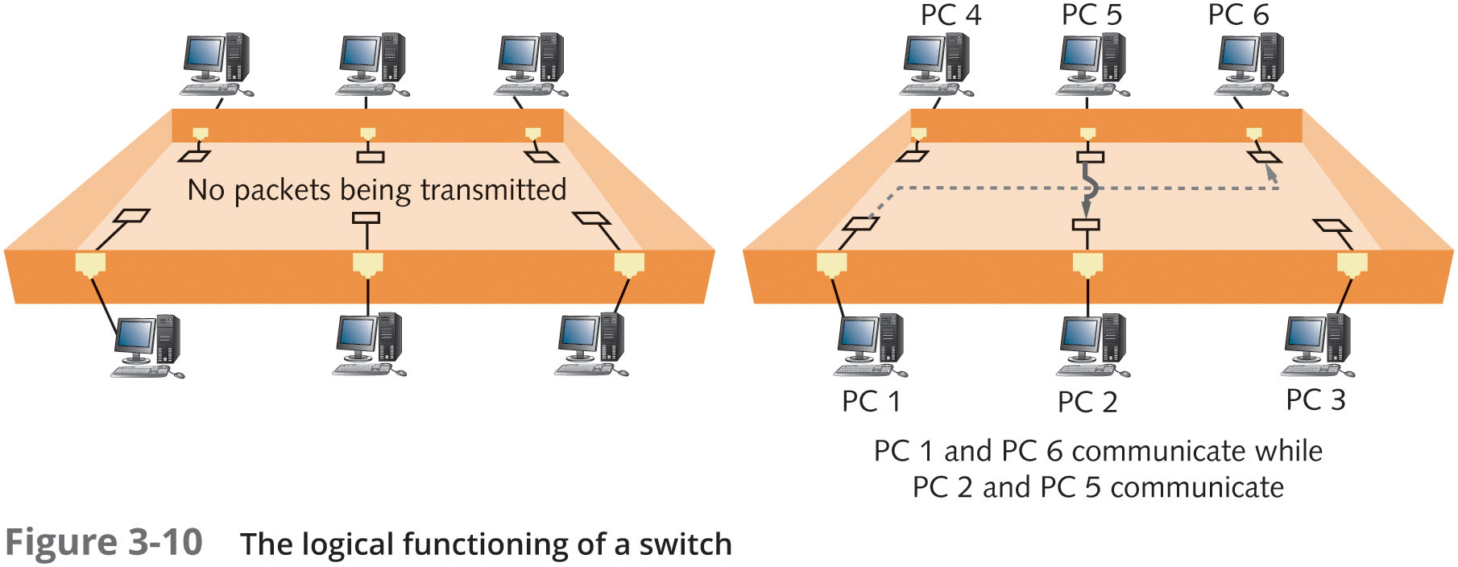
Logical Topologies

Slide 25
Network Technologies
Network technology is the method a network interface uses to access the medium and send data frames and the structure of these frames
Other terms:
Network interface layer technologies
Network architectures
Data link layer technologies
A network uses Ethernet, 802.11 wireless, or some combination of these to move data from device to device in your network
WAN examples include
Frame relay, SONET, and ATM
The network technology often defines frame format and media

Slide 26
Network Technologies and Media
Unshielded Twisted Pair
Unshielded twisted pair (UTP) is the most common media type in LANs
Consists of 4 pairs of copper wires
each twisted together
Comes in numbered categories
The higher the number, the higher the cable’s bandwidth potential
Fiber-optic Cabling
Fiber-optic cabling uses thin strands of glass to carry pulses of light long distances and at high data rates
Isn’t susceptible to electrical interference
Coaxial Cable
Coaxial cable is obsolete as a LAN medium but it is used as the network medium for Internet access via cable modem

Slide 27
Network Technologies and Media
Baseband and Broadband Signaling
Network technologies can use media to transmit signals in two main ways
Baseband sends digital signals in which each bit of data is represented by a pulse of electricity or light
Sent at a single fixed frequency and no other frames can be sent along with it
Broadband uses analog techniques to encode binary 1s and 0s across a continuous range of values
Signals flow at a particular frequency and each frequency represents a channel of data

Slide 28
Ethernet Networks
Ethernet is the most popular LAN technology
Advantages include ease of installation, scalability, media support, and low cost
It supports a broad range of speeds: 10 Mbps to 10 Gbps
Ethernet can operate a in physical bus or physical star and logical bus or switched logical topology
Most NICs/hubs/switches can operate at multiple speeds: 10/100/1000
Underlying technology is the same, regardless of speed

Slide 29
Ethernet Networks
Ethernet Addressing
Every station has a physical (MAC) address
Each MAC address has 48 bits expressed as 12 hexadecimal digits
Incoming frames are read for the destination MAC address and to see if they match the NIC’s own MAC address
If they match or if the destination address is the broadcast MAC address:
Incoming frames are sent to the network protocol for further processing

Slide 30
Ethernet Networks
Ethernet Frames
A frame is the unit of network information that NICs and switches work with
Frames must be between 64 and 1518 bytes and consist of the following:
A 14-byte frame header composed of these three fields:
Destination MAC (6 bytes)
Source MAC (6 bytes)
Type (2 bytes)
Data field from 45 to 1500 bytes
A frame trailer (frame check sequence [FCS]) of 4 bytes

Slide 31
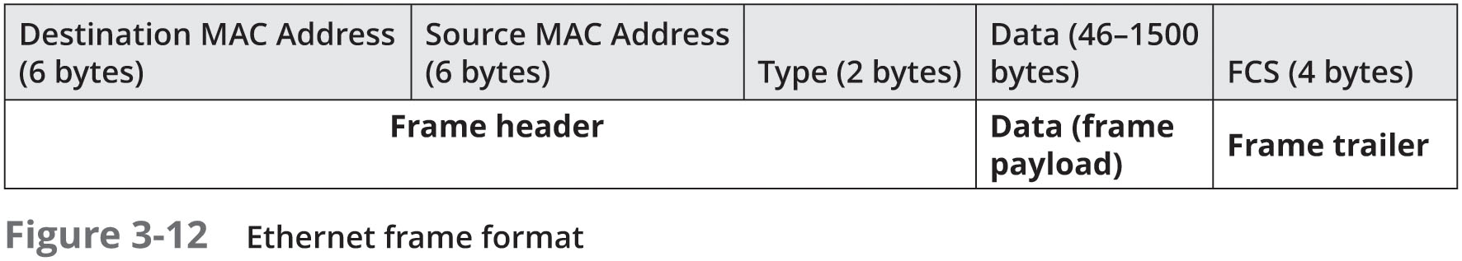
Ethernet Networks

Slide 32
Ethernet Networks
Ethernet Media Access
Media access method is a set of rules governing how and when the medium can be accessed for transmission
Ethernet uses Carrier Sense Multiple Access with Collision Detection (CSMA/CD)
Carrier Sense: Listen before send – must hear silence
Multiple Access: If two or more stations hear silence, multiple stations may transmit at the same time
Collision Detection: If two or more stations transmit, a collision occurs and is detected by the NIC; all stations must retransmit

Slide 33
Ethernet Networks
Collisions and Collision Domains
All devices interconnected by one or more hubs hear all signals generated by all other devices
The extent to which signals in an Ethernet bus topology network are propagated is called a collision domain
All devices in a collision domain are subject to the possibility that whenever a device sends a frame, a collision might occur

Slide 34
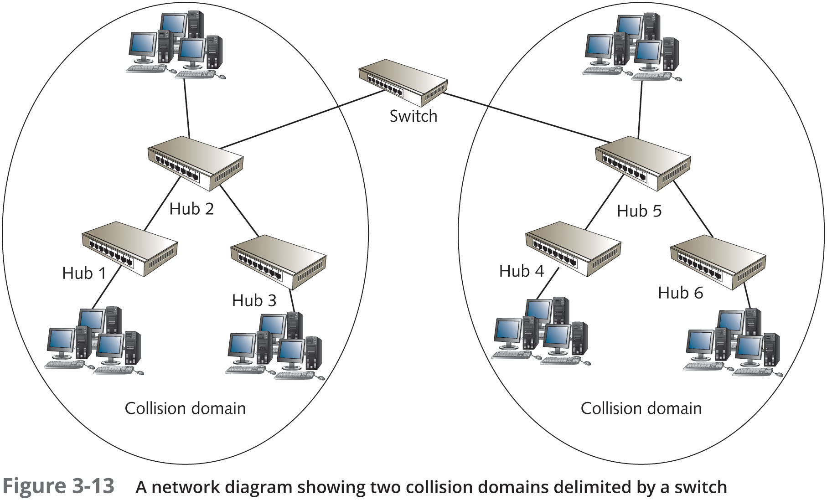
Ethernet Networks

Slide 35
Ethernet Networks
Ethernet Error Handling
Ethernet is a best-effort delivery system
There’s no acknowledgement or verification that the frame arrived at its intended destination
Ethernet relies on network protocols to ensure delivery
Ethernet detects damaged frames
The error-checking code in an frame’s trailer is called a Cyclic Redundancy Check (CRC)
Ethernet uses the CRC to determine that data is unchanged
If a frame is detected as damaged, it is discarded with no notification

Slide 36
Ethernet Networks
Half-Duplex versus Full-Duplex Communication
Half-duplex works like a two-way radio; you can talk and listen but not both at the same time
Ethernet on hubs works only in half-duplex
Full-duplex means NIC/switch can transmit/receive simultaneously
CSMA/CD is not used because a collision cannot occur in full-duplex mode
Most switches operate in full-duplex

Slide 37
Ethernet Standards
Standards Terminology
Ethernet standards expressed in one of two ways:
Using the IEEE document number defining the standard (IEEE 802.3)
XBaseY – 10BaseT, 100BaseT, 100BaseFX
X – designates the speed of transmission
Y – specifies the type of media (T = twisted-pair, FX = fiber optic)
10BaseT Ethernet
Uses two of the four wire pairs
Runs over Category 3 or higher UTP cabling
Highly susceptible to collisions and is obsolete

Slide 38
Ethernet Standards
100BaseTX Ethernet
Most common Ethernet variety
Runs over Category 5 or higher UTP
Uses two of four wire pairs
Also sometimes called “Fast Ethernet”
100BaseFX Ethernet
Runs over two strands of fiber optic cabling
Typically used as backbone cabling between hubs or switches
Also used to connect clients or servers when immunity to noise and eavesdropping is required

Slide 39
Ethernet Standards
1000BaseT Ethernet
Usually called “Gigabit Ethernet”
Runs over Category 5e or higher UTP and uses all four wire pairs
To support full-duplex transmission over a single pair of wires:
1000BaseT uses hybrid and canceller technology, which combines multiple signals and cancels interference
2.5GBaseT and 5GBaseT
This specification was largely in response to increasing Wi-Fi speeds
Faster wired Ethernet speeds are needed as uplink ports from new 802.11ac APs
Runs over Cat 5e/6 cabling

Slide 40
Ethernet Standards
10GBaseT Ethernet
Runs over four pairs of Category 6A or 7 UTP
Operates only in full-duplex mode
No hubs, only switches support 10GBaseT
Still considered an expensive option, although prices are dropping
Good for network servers so they can keep up with desktop systems that commonly operate at 1 Gbps

Slide 41
Additional Ethernet Standards
100BaseT4
Uses all four pairs of wires in UTP Category 3 cable
Obsolete
1000BaseLX
Uses fiber-optic media
“L” stands for “long wavelength” laser
Supports a maximum cable segment length of 5000 meters
Some manufacturers have extended it by using specialized and proprietary optical transceivers

Slide 42
Additional Ethernet Standards
1000BaseSX
Uses fiber-optic media
“S” stands for “short wavelength” laser
Can’t cover as much distance as long-wavelength lasers, but are less expensive
1000BaseCX
Uses specially shielded, balanced, copper jumper cables
Might also be called “twinax” or “short-haul” copper cables

Slide 43
Additional Ethernet Standards
10 Gigabit Ethernet IEEE 802.3ae Standards
Much like the others in frame formats and media access
Defined to run only on fiber-optic cabling and specifies a maximum distance of 40 kilometers
Primarily used for network backbones
Varieties:
10GBaseSR, 10GBaseLR, 10GBaseER, 10GBaseSW, 10GBaseLW, and 10GBaseEW

Slide 44
Additional Ethernet Standards
40 Gigabit and 100 Gigabit Ethernet
Very high cost is still prohibitive
Adoption has been slow
Fiber-optic cabling is primary medium
Although there are provisions to use special copper assemblies over short distances
What’s Next for Ethernet?
Estimations are that Ethernet speeds will continue to increase
With Terabit Ethernet (1000 Gbps) as part of the discussion
Work on a 200 and 400 Gbps standard was completed in 2017
Devices are not yet readily available

Slide 45
802.11 Wi-Fi
The 802.11 wireless networking standard is also referred to as Wireless Fidelity (Wi-Fi)
In most towns you can usually find a public Wi-Fi network, called a hotspot
802.11 is essentially an extension to Ethernet
Using airwaves instead of cabling as the medium

Slide 46
Wi-Fi Modes of Operation
Wi-Fi can operate in one of two modes
Infrastructure mode use a central access point (AP)
Stations connect through a wireless AP before they can communicate with other devices
Ad hoc mode is a mode of operation where there is no central device
Data travels from device to device like a bus
Sometimes called “peer-to-peer mode”
Most of this chapter’s discussion of Wi-Fi focuses on infrastructure mode

Slide 47
Wi-Fi Channels and Frequencies
Wi-Fi networks operate at one of two radio frequencies: 2.4GHz and 5.0 GHz
Although this frequency is not fixed
2.4 GHz is actually 2.412 thru 2.484 divided into 14 channels spaced 5 MHz apart
5.0 GHz is actually 4.915 thru 5.825 GHz divided into 42 channels of 10, 20, or 40 MHz each
A wireless channel works like a TV channel:
You must tune to the correct channel to connect
If you are configuring several Wi-Fi networks:
Choose channels five apart from other known APs

Slide 48
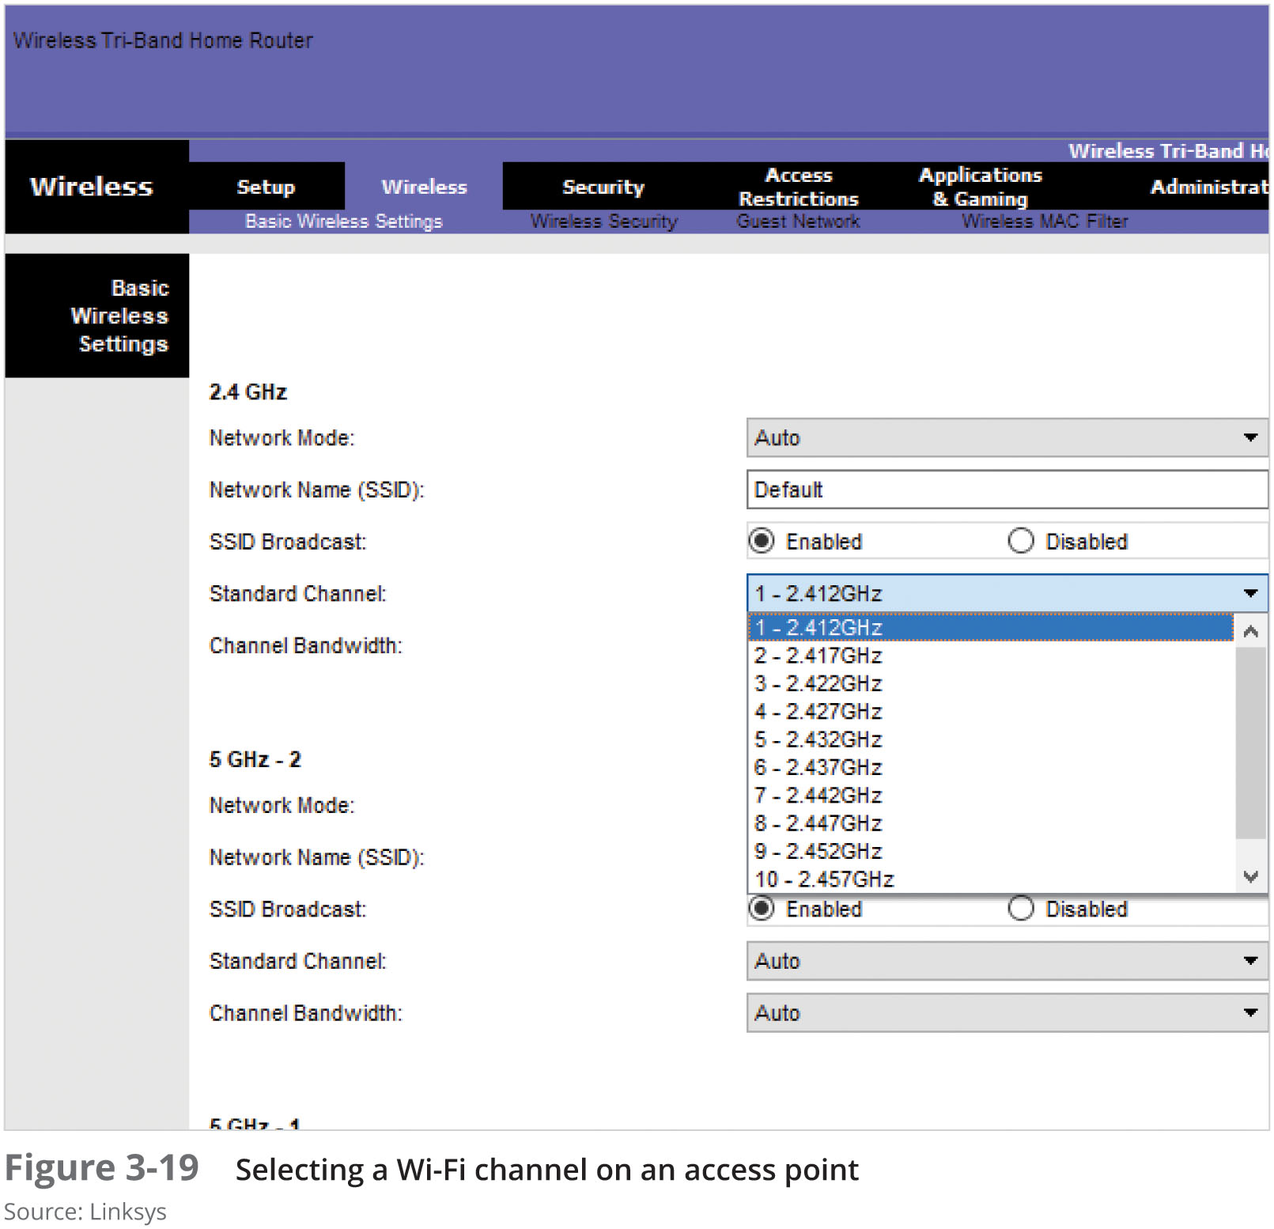
Wi-Fi Channels and Frequencies

Slide 49
Wi-Fi Antennas
The antenna on a Wi-Fi device is both transmitter and receiver
Characteristics and placement determine how well a device transmits or receives Wi-Fi signals
Antennas are usually categorized by their radiation pattern:
Omnidirectional antennas – signals radiate out from the antenna with equal strength in all directions
Unidirectional antenna – signals are focused in a single direction
Ideal for placement at one end of long, narrow spaces

Slide 50
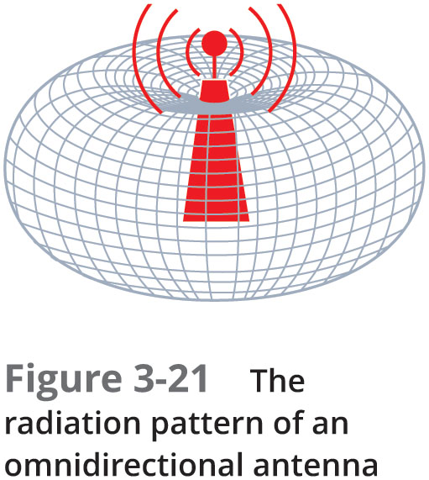
Wi-Fi Antennas

Slide 51
Wi-Fi Access Methods and Operation
Wi-Fi Access Method
Sending station can’t hear if another station begins transmitting so they cannot use the CSMA/CD access method that Ethernet uses
Wi-Fi devices use Carrier Sense Multiple Access with Collision Avoidance (CSMA/CA)
802.11 standards specify a feature that uses handshaking before transmission
Uses request-to-send/clear-to-send (RTS/CTS) packets and acknowledgements
The 802.11b standard specifies a transmission rate of 11 Mbps
But this value is not absolute
Environmental conditions prevent transmission at this speed

Slide 52
Wi-Fi Signal Characteristics
Common types of signal interference caused by physical objects:
Absorption – solid objects absorb radio signals, causing them to attenuate (weaken)
Refraction – the bending of a radio signal as it passes from a medium of one density through a medium of a different density
Diffraction – the altering of a wave as it tries to bend around an object
Reflection – occurs when a signal hits a dense, reflective material, resulting in signal loss
Scattering – when a signal changes direction in unpredictable ways, causing a loss in signal strength

Slide 53
Wi-Fi Signal Characteristics
Signal-to-noise ratio is the amount of noise compared with the signal strength
Noise can come from equipment, other wireless devices, and other wireless networks
Throughput is the actual amount of data transferred
Not counting errors and acknowledgements
Goodput is actual application-to-application data transfer speed
Packet frame headers, acknowledgements, and retransmissions are collectively known as overhead

Slide 54
Wi-Fi Standards
Advantages and disadvantages of each standard:
802.11a – requires more power and has a shorter indoor range, transfers data at 54 Mbps
802.11b – was the most widely accepted standard because of its low cost and good indoor range
Because it operates at only 11 Mbps, 802.11g and 802.11n have rapidly replaced it
802.11g – 2.4 GHz standard that is backward-compatible with 802.11b
Suffers from the same interference problems as 802.11b networks
802.11n – adds multiple-input/multiple-output (MIMO) antennas
MIMO takes advantage of multipath signals by using a separate antenna to process signals as they arrive slightly out of phase

Slide 55
Wi-Fi Standards
Advantages and disadvantages of each standard (continued):
802.11ac – operates in the 5.0 GHz range only and can support data rates up to 1 Gbps
Future implementations will have speeds up to 6.93 Gbps
Improves on the MIMO technology by providing up to eight data streams and introducing multiuser MIMO (MU-MIMO), which allows APs to send data to multiple client stations simultaneously
802.11ax – a work in progress that promises speeds up to 10 Gbps and will possible operate in the 1 GHz and 7 GHz frequency bands
Has been dubbed Wi-Fi 6, with 802.11ac being referred to as Wi-Fi5, and 802.11n is now called Wi-Fi 4

Slide 56
Wi-Fi Security
Signals from a Wi-Fi network can travel several hundred feet – Wi-Fi devices outside your home or business can detect your signals
Wi-Fi network should be protected by an encryption protocol that makes data difficult to interpret
Encryption protocols
Wired equivalent privacy (WEP), Wi-Fi Protected Access (WPA), and WPA2,
Not all devices support all three protocols
Older devices might only support WEP and/or WPA
Wi-Fi encryption is configured on the AP

Slide 57
Token Ring Networks
Based on the IEEE 802.5 standard
Token Ring networks are cabled in a star physical topology but function as a logical ring topology
Originally operated at 4Mbps and then increased to 16 Mbps and later 100 Mbps
Uses cat 4 and higher UTP
Token Ring Media Access
A token is passed along the network
Only the station with the token can transmit
Frames are acknowledged and token is released
No collisions
Token ring is no longer a widely used LAN technology

Slide 58
Fiber Distributed Data Interface Technology
FIDDI uses a token-passing access method and dual rings for redundancy
Usually a physical ring of fiber-optic cable
FIDDI transmits at 100 Mbps and can include up to 500 nodes over a distance of 60 miles
FIDDI full-duplex technology can support up to 200 Mbps
An FIDDI network has no hubs
Devices called “concentrators” can server as a central connection point for buildings or sites in a campus setting
Obsolete on new networks

Slide 59
Summary
Networks can be described by a physical and logical topology
Physical topology describes the arrangement of cabling that connects one device to another
Logical topology describes the path data travels between devices
The main physical topologies are the bus, star, ring, and point-to-point
A star topology, along with the extended star, is the most common for implementing LANs
The main logical topologies are bus, ring, and switched
A network technology defines the structure of the frames and how a network interface access the medium to send data frames

Slide 60
Summary
The most common network technology for LANs is Ethernet
Wi-Fi is a wireless technology based on Ethernet but uses the CSMA/CA media access method
The antenna on a Wi-Fi device is both the transmitter and receiver
Wi-Fi signal interference can severely affect a WLAN’s performance and reliability
Token Ring and FDDI are both obsolete technologies that used a token passing access method

